Slide 1
Chapter 5-2
C Functions
C How to Program, 8/e

Slide 2
Function Call Stack and Stack Frames
To understand how C performs function calls, we first need to consider a data structure (i.e., collection of related data items) known as a stack.
Think of a stack as analogous to a pile of dishes.
When a dish is placed on the pile, it’s normally placed at the top (referred to as pushing the dish onto the stack).
Similarly, when a dish is removed from the pile, it’s normally removed from the top (referred to as popping the dish off the stack).
Stacks are known as last-in, first-out (LIFO) data structures—the last item pushed (inserted) on the stack is the first item popped (removed) from the stack.

Slide 3
Function Call Stack and Stack Frames (Cont.)
An important mechanism for computer science students to understand is the function call stack (sometimes referred to as the program execution stack).
This data structure—working “behind the scenes”—supports the function call/return mechanism.
It also supports the creation, maintenance and destruction of each called function’s local variables.

Slide 4
Function Call Stack and Stack Frames (Cont.)
As each function is called, it may call other functions, which may call other functions—all before any function returns.
Each function eventually must return control to the function that called it.
So, we must keep track of the return addresses that each function needs to return control to the function that called it.
The function call stack is the perfect data structure for handling this information.

Slide 5
Function Call Stack and Stack Frames (Cont.)
Each time a function calls another function, an entry is pushed onto the stack.
This entry, called a stack frame, contains the return address that the called function needs in order to return to the calling function.
If the called function returns, instead of calling another function before returning, the stack frame for the function call is popped, and control transfers to the return address in the popped stack frame.

Slide 6
Function Call Stack and Stack Frames (Cont.)
Each called function always finds the information it needs to return to its caller at the top of the call stack.
And, if a function makes a call to another function, a stack frame for the new function call is simply pushed onto the call stack.
Thus, the return address required by the newly called function to return to its caller is now located at the top of the stack.

Slide 7
Function Call Stack and Stack Frames (Cont.)
The stack frames have another important responsibility.
Most functions have automatic variables—parameters and some or all of their local variables.
Automatic variables need to exist while a function is executing.
They need to remain active if the function makes calls to other functions.
But when a called function returns to its caller, the called function’s automatic variables need to “go away.”

Slide 8
Function Call Stack and Stack Frames (Cont.)
The called function’s stack frame is a perfect place to reserve the memory for automatic variables.
That stack frame exists only as long as the called function is active.
When that function returns—and no longer needs its local automatic variables—its stack frame is popped from the stack, and those local automatic variables are no longer known to the program.

Slide 9
Function Call Stack and Stack Frames (Cont.)
Of course, the amount of memory in a computer is finite, so only a certain amount of memory can be used to store stack frames on the function call stack.
If more function calls occur than can have their stack frames stored on the function call stack, a fatal error known as a stack overflow occurs.

Slide 10
Function Call Stack and Stack Frames (Cont.)
Function Call Stack in Action
Now let’s consider how the call stack supports the operation of a square function called by main
First the operating system calls main—this pushes a stack frame onto the stack.
The stack frame tells main how to return to the operating system (i.e., transfer to return address R1) and contains the space for main’s automatic variable (i.e., a, which is initialized to 10).

Slide 11
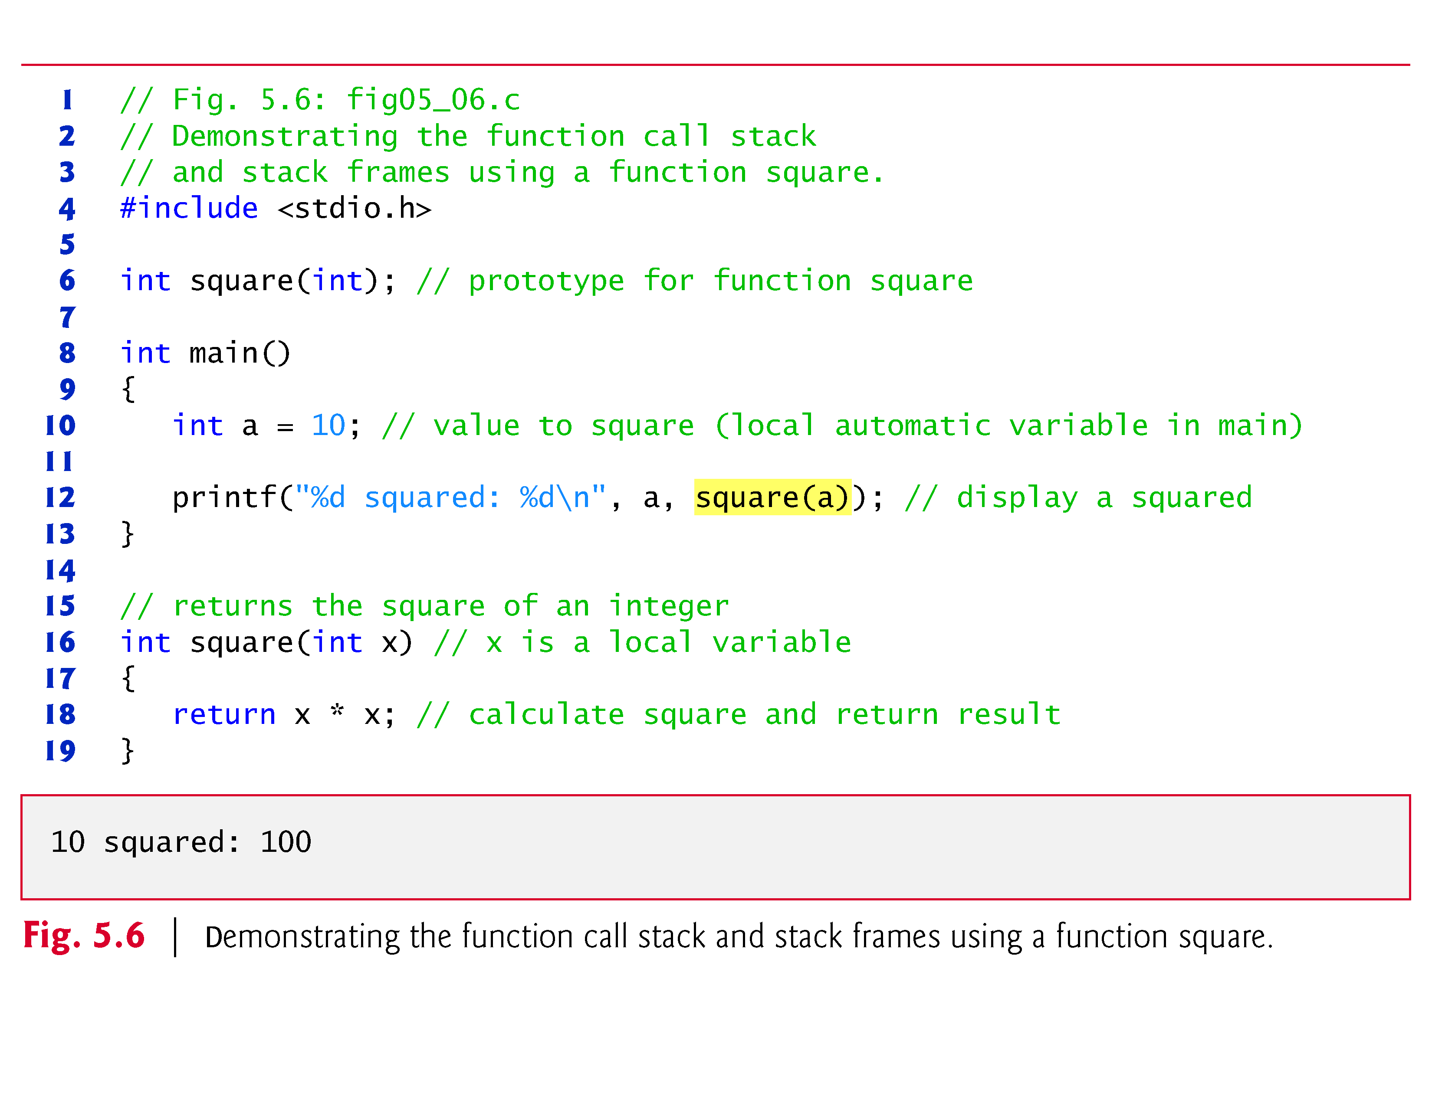

Slide 12
Function Call Stack and Stack Frames (Cont.)
Function main—before returning to the operating system—now calls function square
This causes a stack frame for square to be pushed onto the function call stack (Fig. 5.8).
This stack frame contains the return address that square needs to return to main (i.e., R2) and the memory for square’s automatic variable (i.e., x).

Slide 13
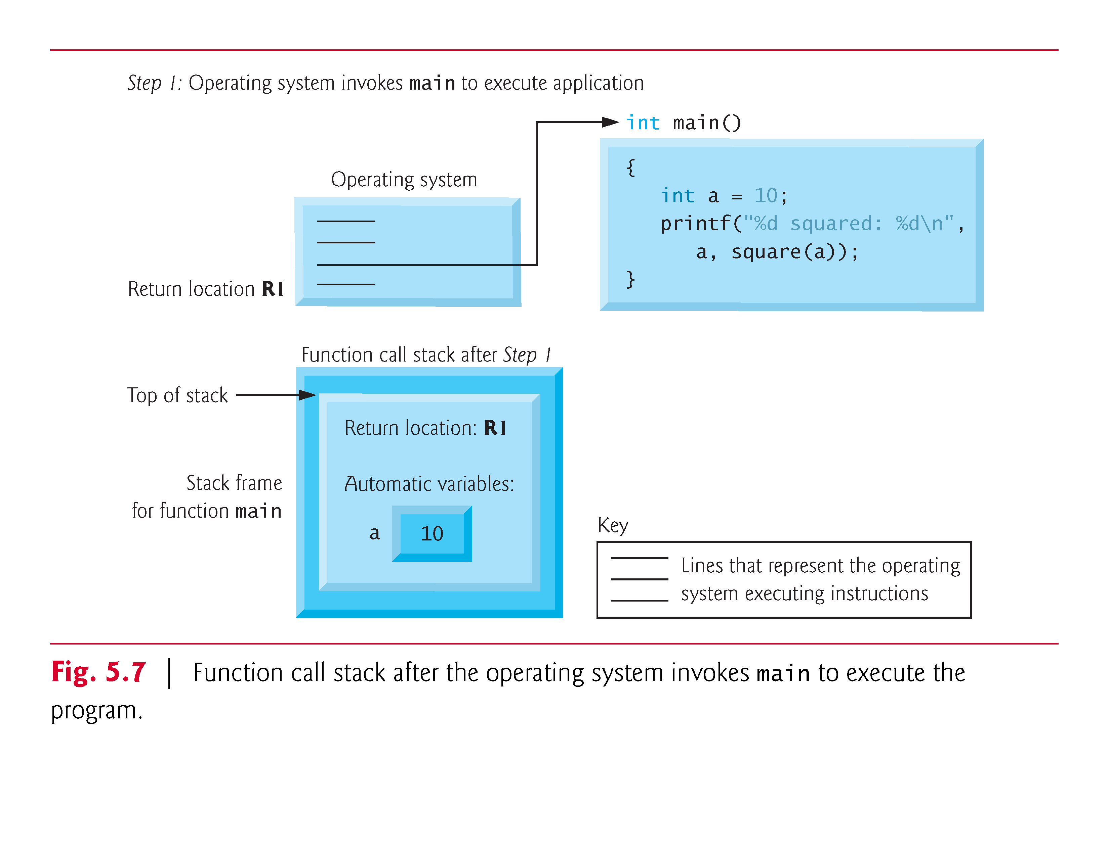

Slide 14
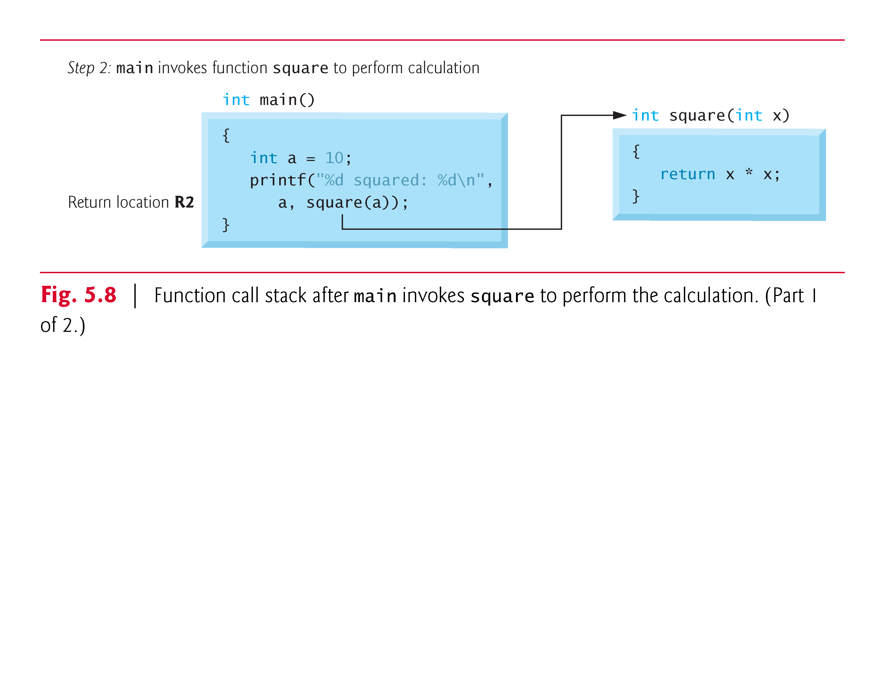
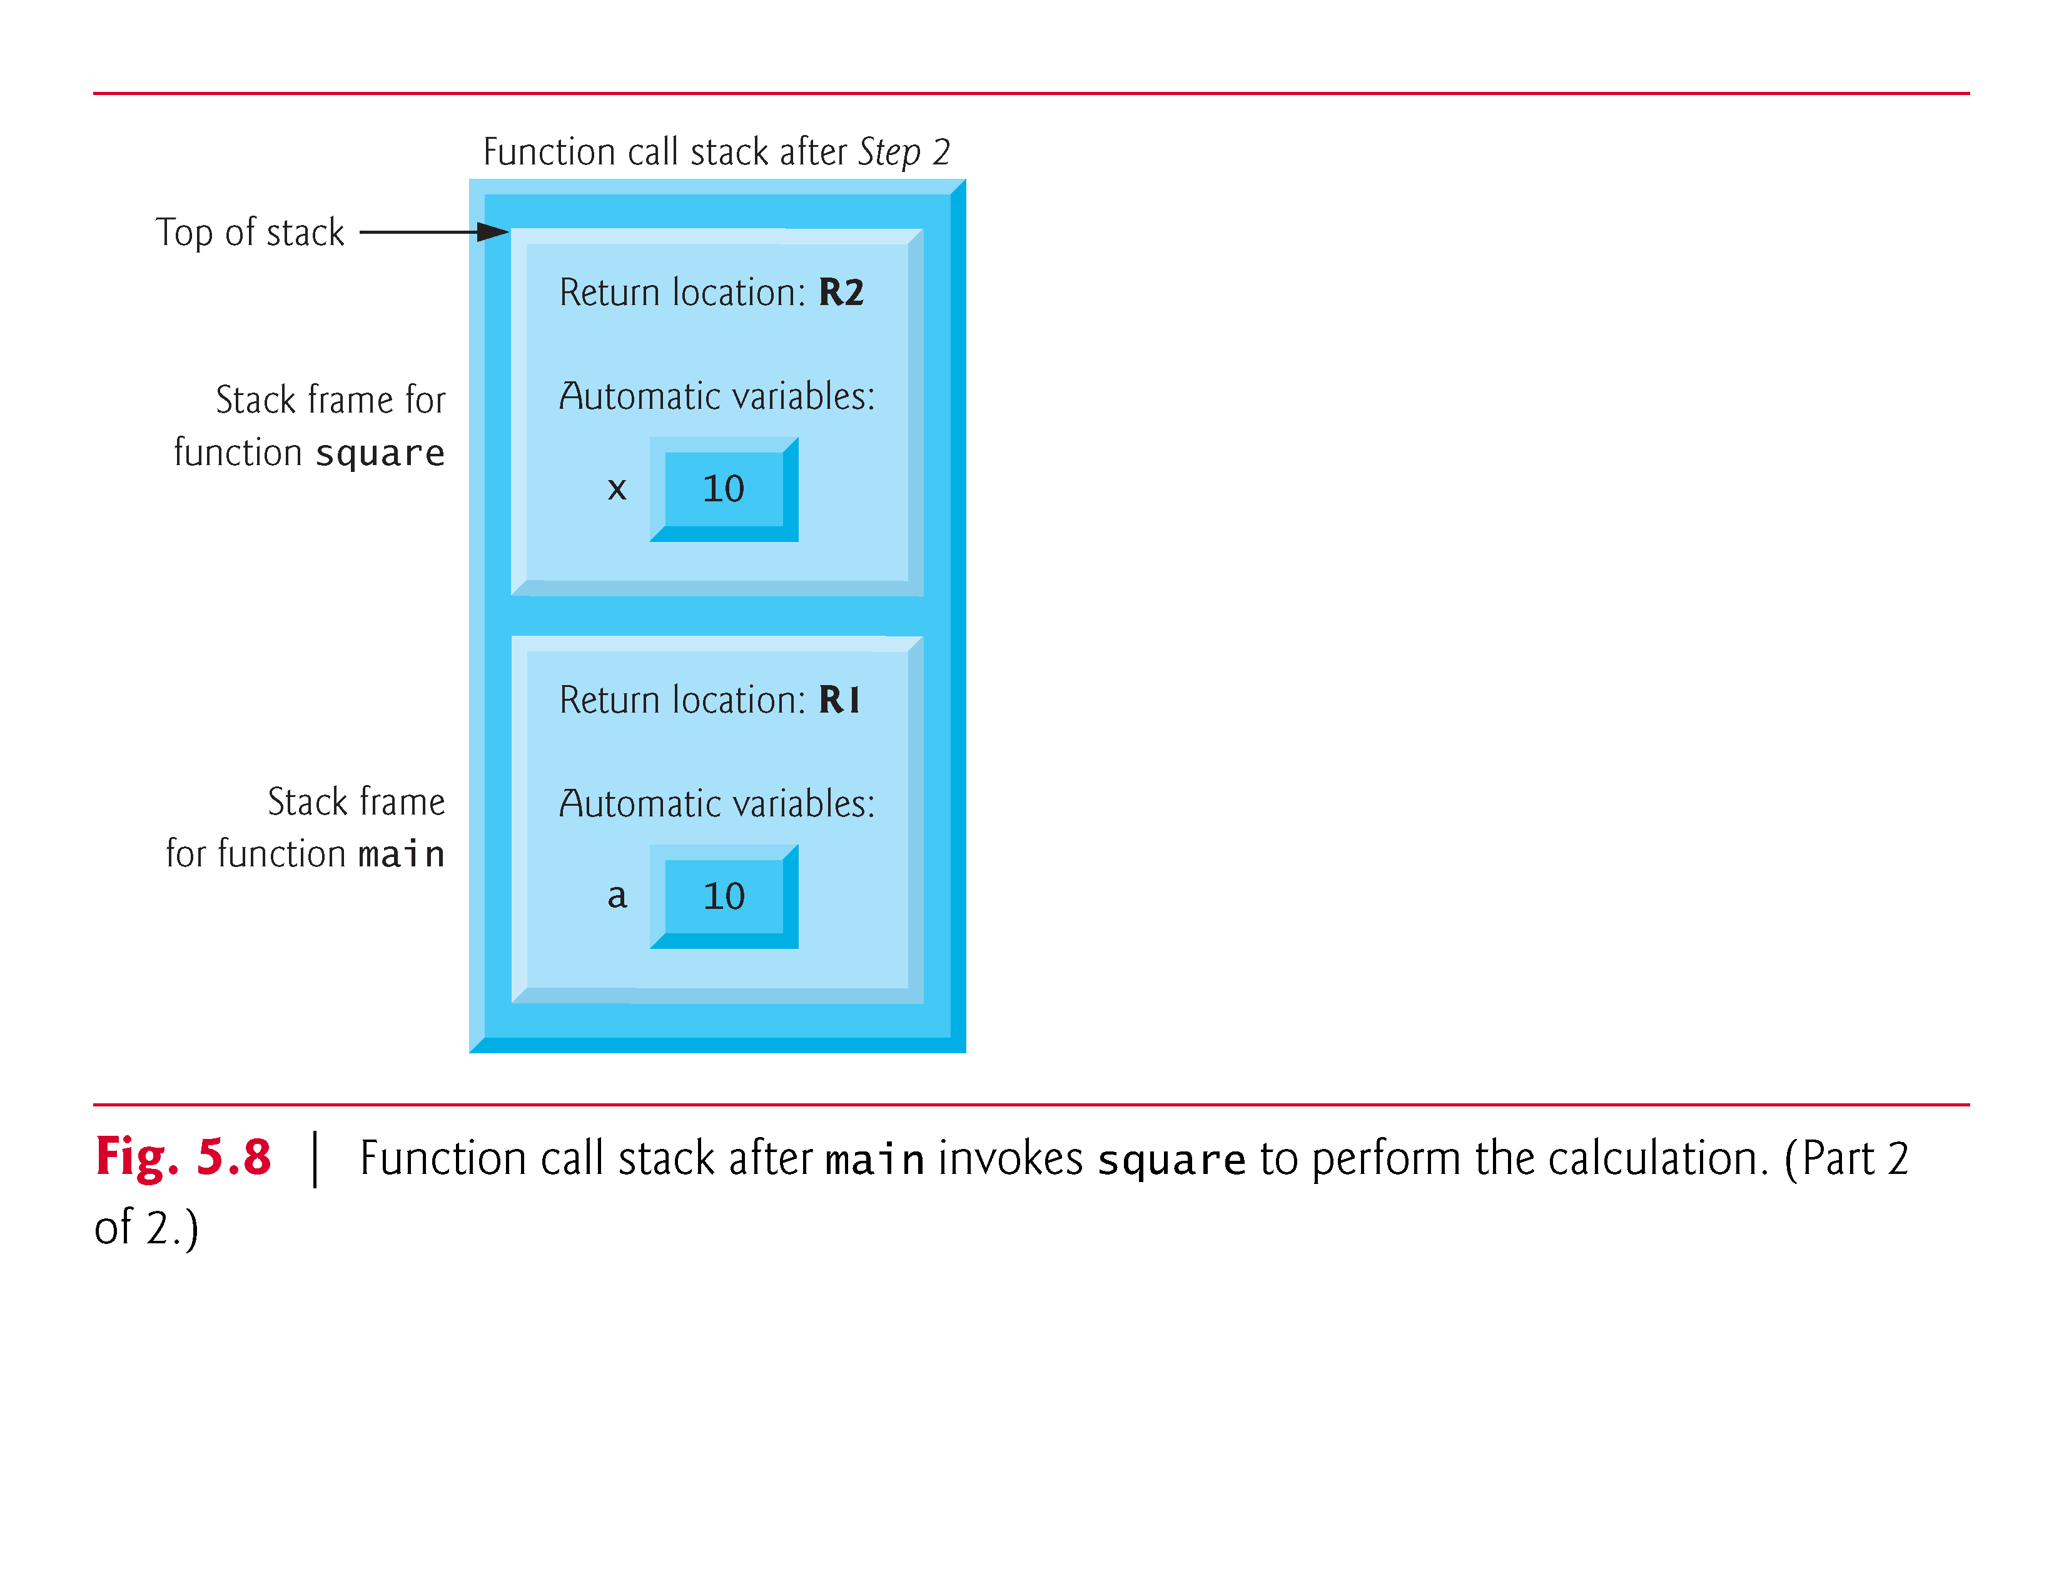

Slide 15
Function Call Stack and Stack Frames (Cont.)
After square calculates the square of its argument, it needs to return to main—and no longer needs the memory for its automatic variable x.
So the stack is popped—giving square the return location in main (i.e., R2) and losing square’s automatic variable.
Figure 5.9 shows the function call stack after square’s stack frame has been popped.

Slide 16
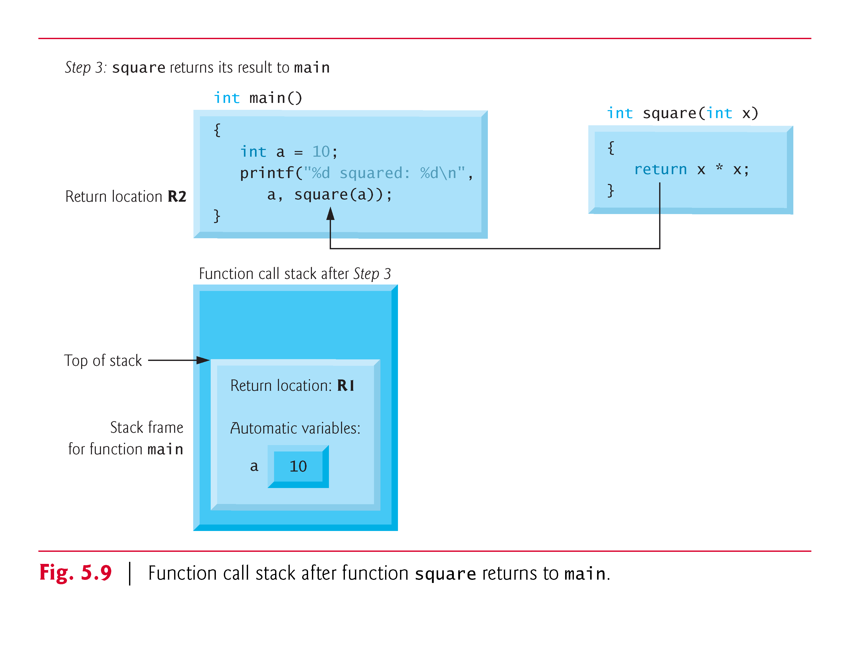

Slide 17
Function Call Stack and Stack Frames (Cont.)
Function main now displays the result of calling square
Reaching the closing right brace of main causes its stack frame to be popped from the stack, gives main the address it needs to return to the operating system (i.e., R1 in Fig. 5.7) and causes the memory for main’s automatic variable (i.e., a) to become unavailable.

Slide 18
Passing Arguments By Value and By Reference
In many programming languages, there are two ways to pass arguments—pass-by-value and pass-by-reference.
When arguments are passed by value, a copy of the argument’s value is made and passed to the called function.
Changes to the copy do not affect an original variable’s value in the caller.
When an argument is passed by reference, the caller allows the called function to modify the original variable’s value.

Slide 19
Passing Arguments By Value and By Reference (Cont.)
Pass-by-value should be used whenever the called function does not need to modify the value of the caller’s original variable.
This prevents the accidental side effects (variable modifications) that so greatly hinder the development of correct and reliable software systems.
Pass-by-reference should be used only with trusted called functions that need to modify the original variable.
In C, all arguments are passed by value.
In Chapter 6, we’ll see that array arguments are automatically passed by reference for performance reasons.

Slide 20
Example: A Game of Chance
One of the most popular games of chance is a dice game known as “craps.” The rules of the game are simple.
  A player rolls two dice. Each die has six faces. These faces contain 1, 2, 3, 4, 5, and 6 spots. After the dice have come to rest, the sum of the spots on the two upward faces is calculated. If the sum is 7 or 11 on the first throw, the player wins. If the sum is 2, 3, or 12 on the first throw (called “craps”), the player loses (i.e., the “house” wins). If the sum is 4, 5, 6, 8, 9, or 10 on the first throw, then that sum becomes the player’s “point.” To win, you must continue rolling the dice until you “make your point.” The player loses by rolling a 7 before making the point.

Slide 21
Self-Assessment Quiz
What is the output of the following program?
#include <stdio.h>
void swap(int a,int b){
int temp = a;
a = b;
b = temp;
}
int main(void) {
int i = 5;
int j = 3;
swap(i,j);
printf("i = %d, j = %d\n", i, j);
}
a
i = 3, j = 5
b
i = 5, j = 5
c
i = 5, j = 3
d
It will generate run-time error.

Slide 22
Quiz Result
Sorry, your answer is wrong ☹
#include <stdio.h>
void swap(int a,int b){
int temp = a;
a = b;
b = temp;
}
int main(void) {
int i = 5;
int j = 3;
swap(i,j);
printf("i = %d, j = %d\n", i, j);
}
Try Again!

Slide 23
Quiz Result:
Excellent! ☺
What is the output of the following program?
#include <stdio.h>
void swap(int a,int b){
int temp = a;
a = b;
b = temp;
}
int main(void) {
int i = 5;
int j = 3;
swap(i,j);
printf("i = %d, j = %d\n", i, j);
}
i = 5, j = 3
Continue

Slide 24
Storage Classes
Each identifier in a program has other attributes, including storage class: storage duration, scope and linkage.
C provides the storage class specifiers: auto, register, extern and static.
An identifier’s storage class determines its storage duration, scope and linkage.

Slide 25
Storage Duration
An identifier’s storage duration is the period during which the identifier exists in memory.
  Some exist briefly
  Some are repeatedly created and destroyed
  Some exist for the program’s entire execution.

Slide 26
Storage Scope
An identifier’s scope is where the identifier can be referenced in a program.
  Some can be referenced throughout a program
  Some can be referenced from only portions of a program.

Slide 27
Storage Classes (Cont.)
The storage-class specifiers can be split into automatic storage duration and static storage duration.
Keyword auto is used to declare variables of automatic storage duration.
Variables with automatic storage duration are created when the block in which they’re defined is entered; they exist while the block is active, and they’re destroyed when the block is exited.

Slide 28
Local Variables
Only variables can have automatic storage duration.
A function’s local variables (those declared in the parameter list or function body) normally have automatic storage duration.
Keyword auto explicitly declares variables of automatic storage duration.
Local variables have automatic storage duration by default, so keyword auto is rarely used.

Slide 29
Static Storage Class
Keyword static is used in the declarations of identifiers for variables and functions of static storage duration.
Identifiers of static storage duration exist from the time at which the program begins execution until the program terminates.
For static variables, storage is allocated and initialized only once, before the program begins execution.
For functions, the name of the function exists when the program begins execution.

Slide 30
Static Storage Class
However, even though the variables and the function names exist from the start of program execution, this does not mean that these identifiers can be accessed throughout the program.
Storage duration and scope (where a name can be used) are separate issues.
There are several types of identifiers with static storage duration: external identifiers (such as global variables and function names) and local variables declared with the storage-class specifier static.

Slide 31
Global Variables
Global variables are created by placing variable declarations outside any function definition, and they retain their values throughout the execution of the program.
Global variables and functions can be referenced by any function that follows their declarations or definitions in the file.
This is one reason for using function prototypes—when we include stdio.h in a program that calls printf, the function prototype is placed at the start of our file to make the name printf known to the rest of the file.

Slide 32
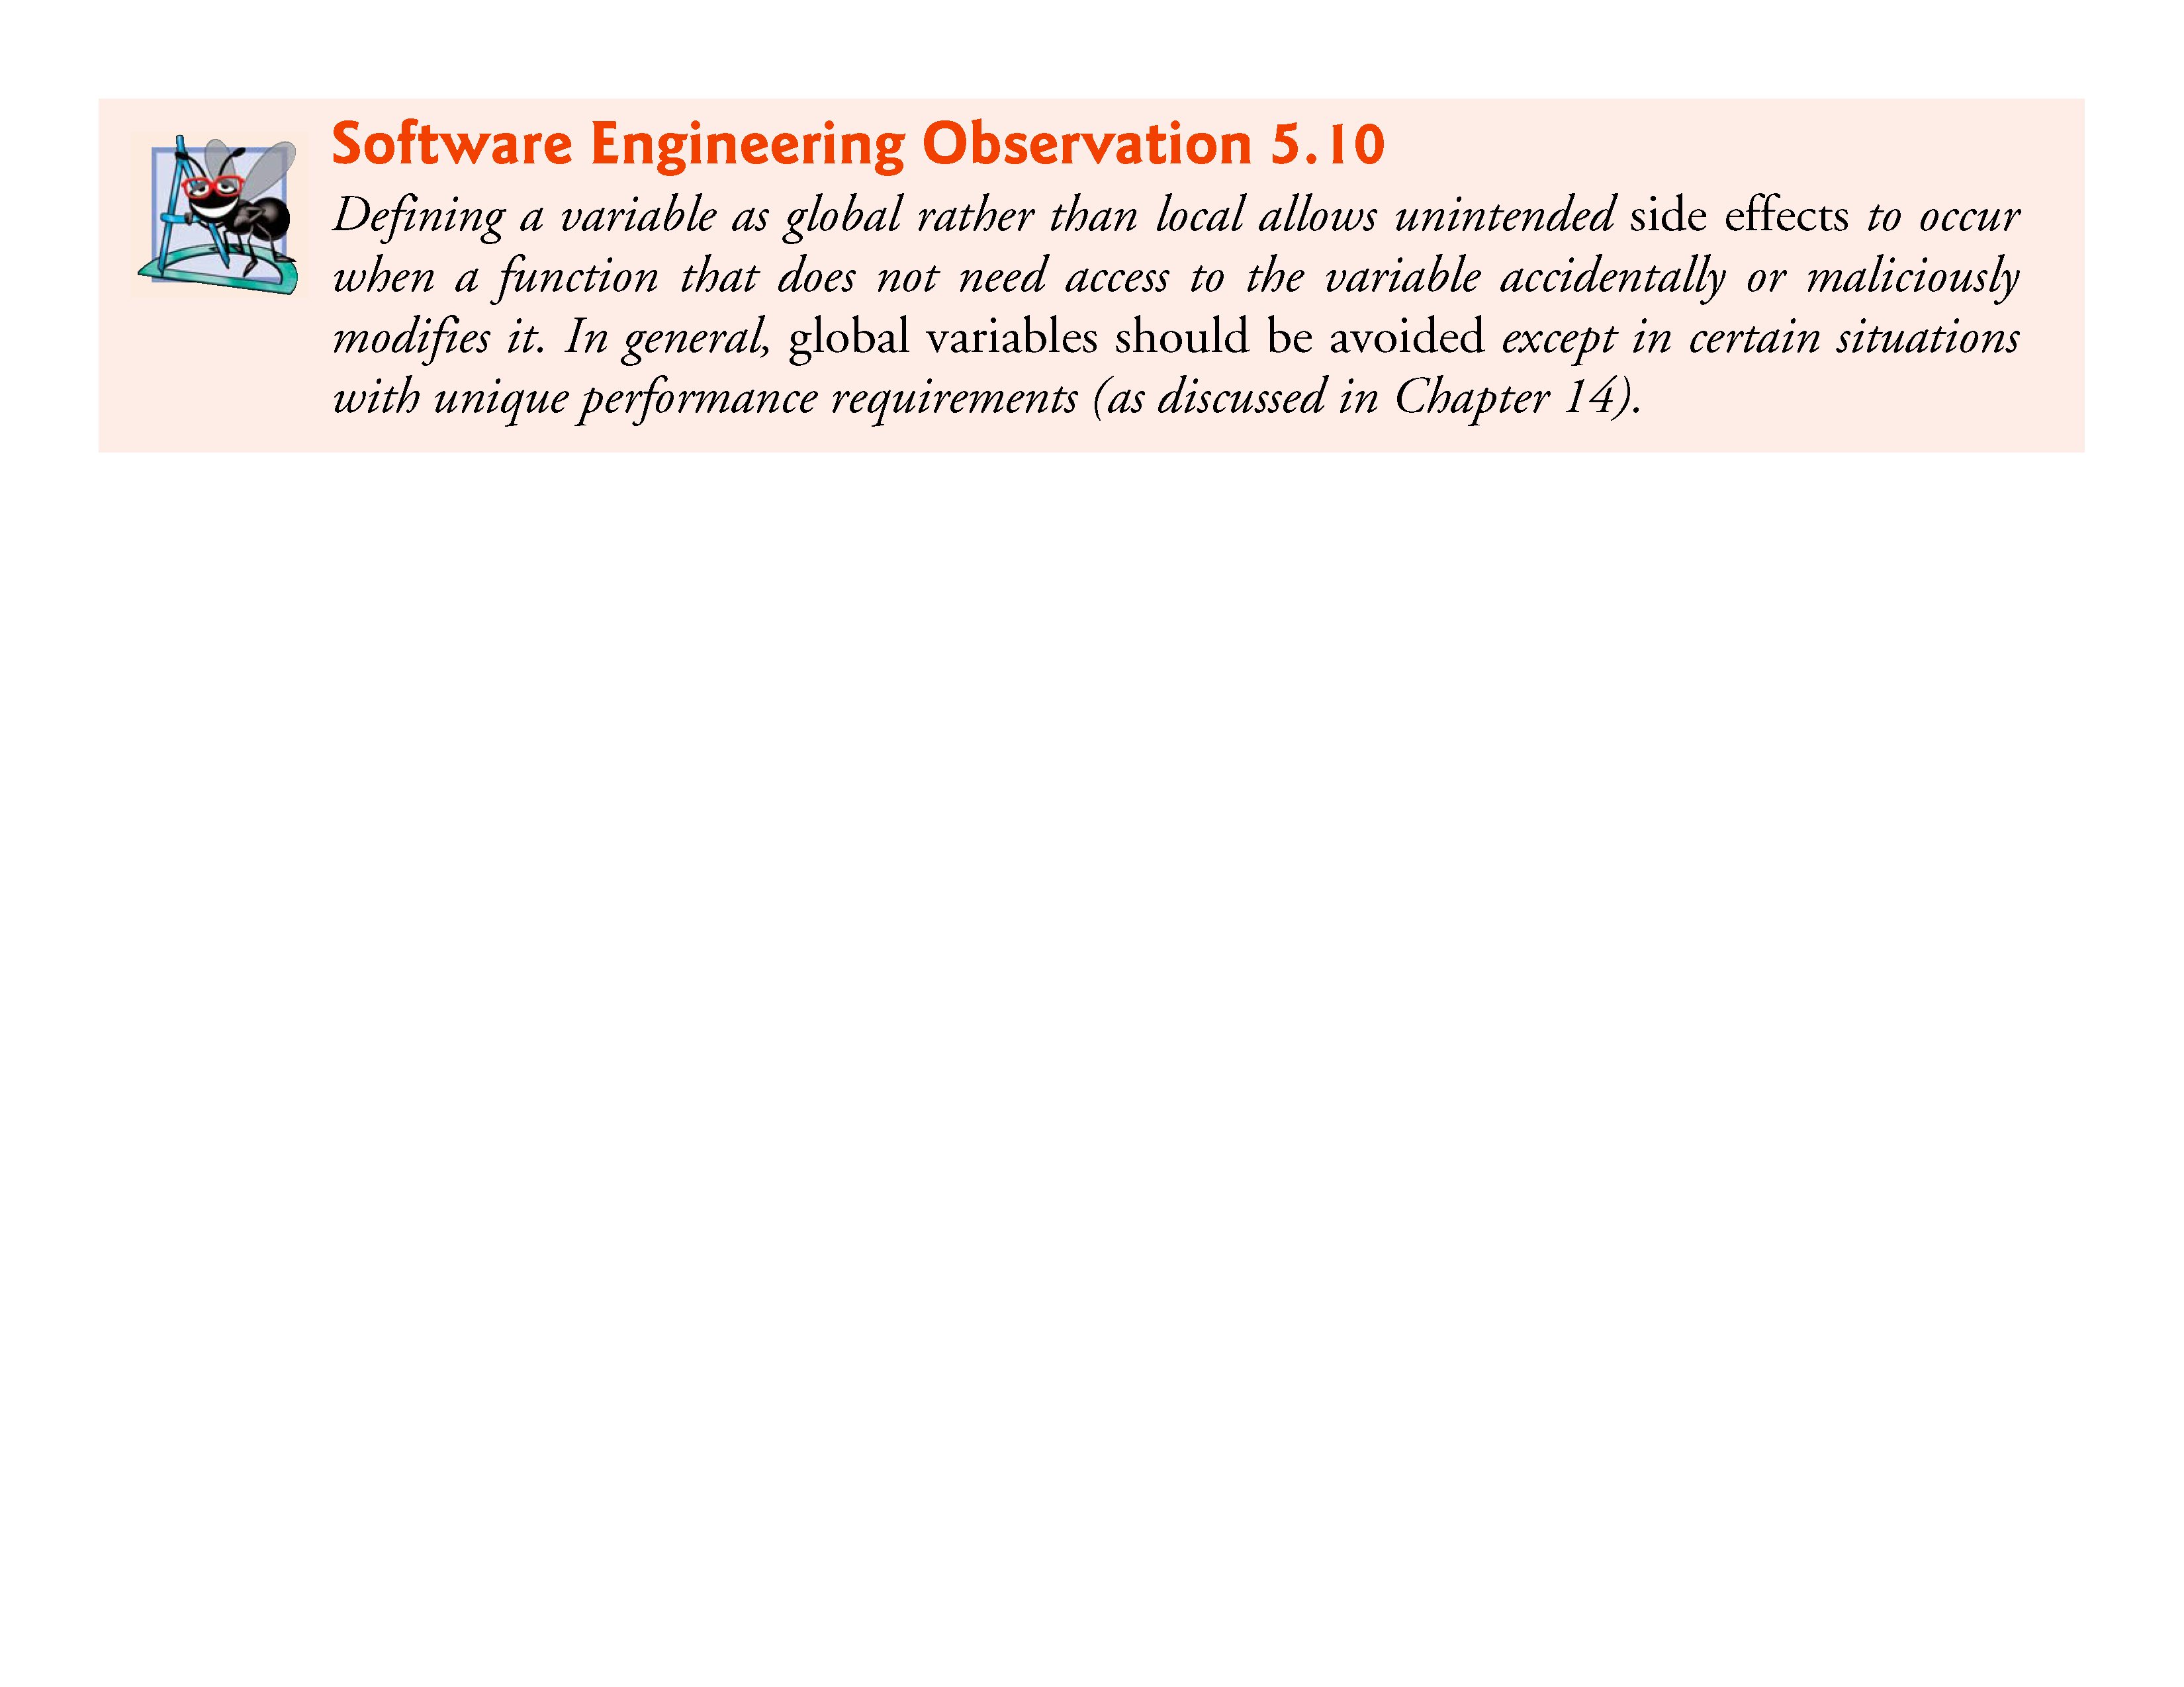
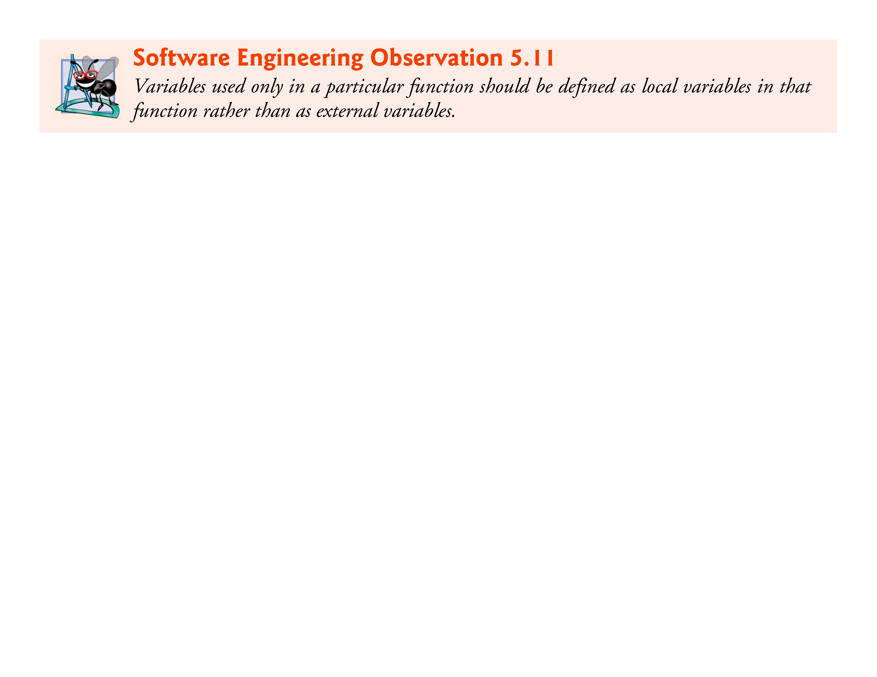

Slide 33
Static Variables
Local variables declared with the keyword static are still known only in the function in which they’re defined, but unlike automatic variables, static local variables retain their value when the function is exited.
The next time the function is called, the static local variable contains the value it had when the function last exited.
The following statement declares local variable count to be static and initializes it to 1.
    static int count = 1;
    All numeric variables of static storage duration are initialized to zero by default if you do not explicitly initialize them.

Slide 34
Scope Rules (Cont.)
Global variables, function definitions, and function prototypes placed outside a function all have file scope.
Identifiers defined inside a block have block scope.
Block scope ends at the terminating right brace (}) of the block.
Local variables defined at the beginning of a function have block scope as do function parameters, which are considered local variables by the function.
Any block may contain variable definitions.

Slide 35
Scope Rules (Cont.)
When blocks are nested, and an identifier in an outer block has the same name as an identifier in an inner block, the identifier in the outer block is “hidden” until the inner block terminates.
This means that while executing in the inner block, the inner block sees the value of its own local identifier and not the value of the identically named identifier in the enclosing block.
Local variables declared static still have block scope, even though they exist from before program startup.

Slide 36
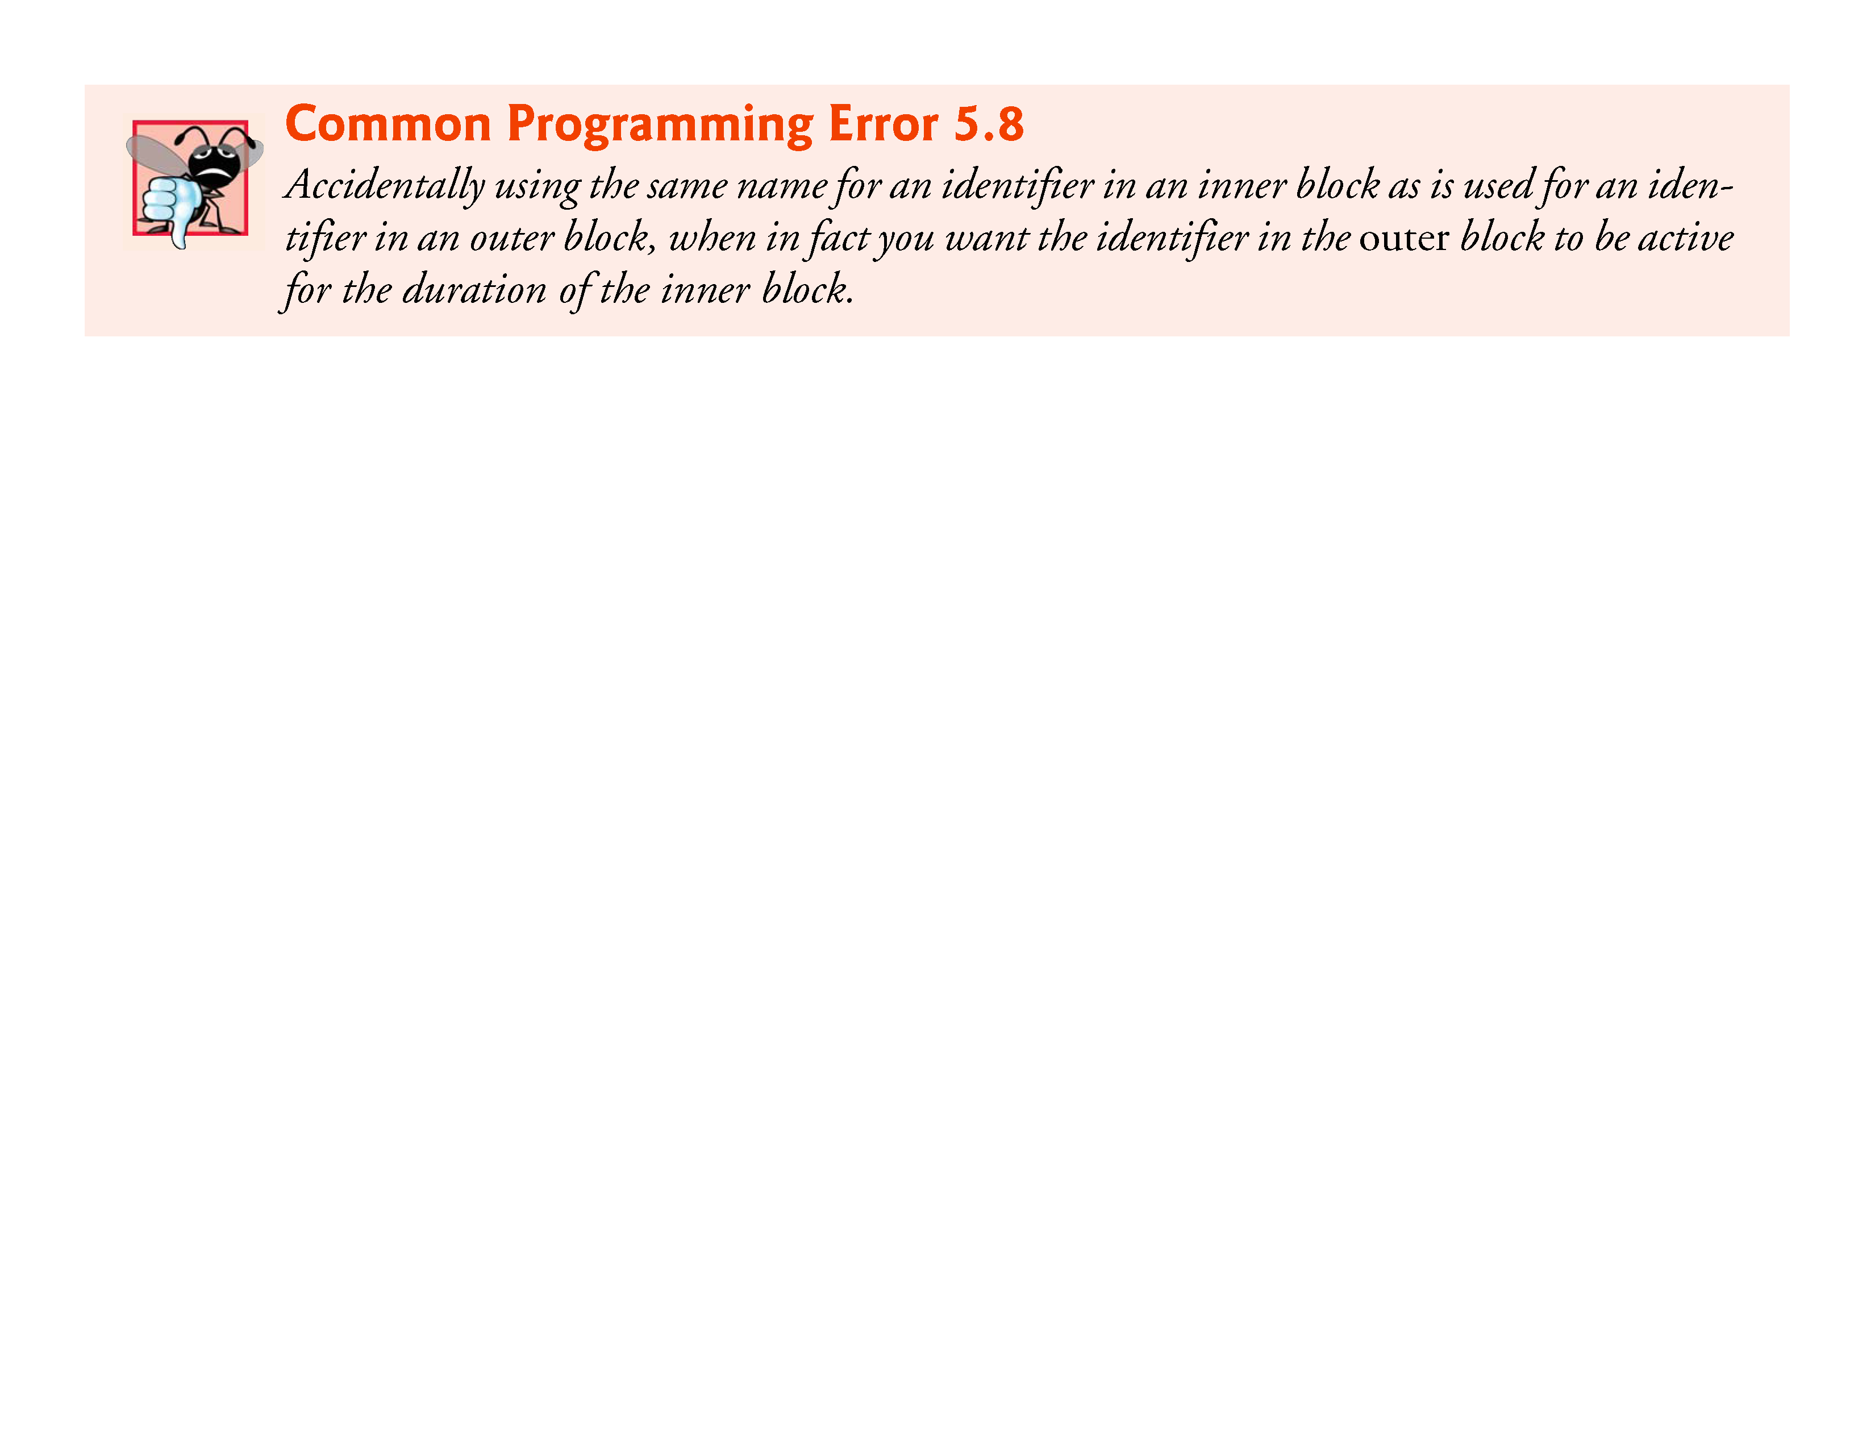
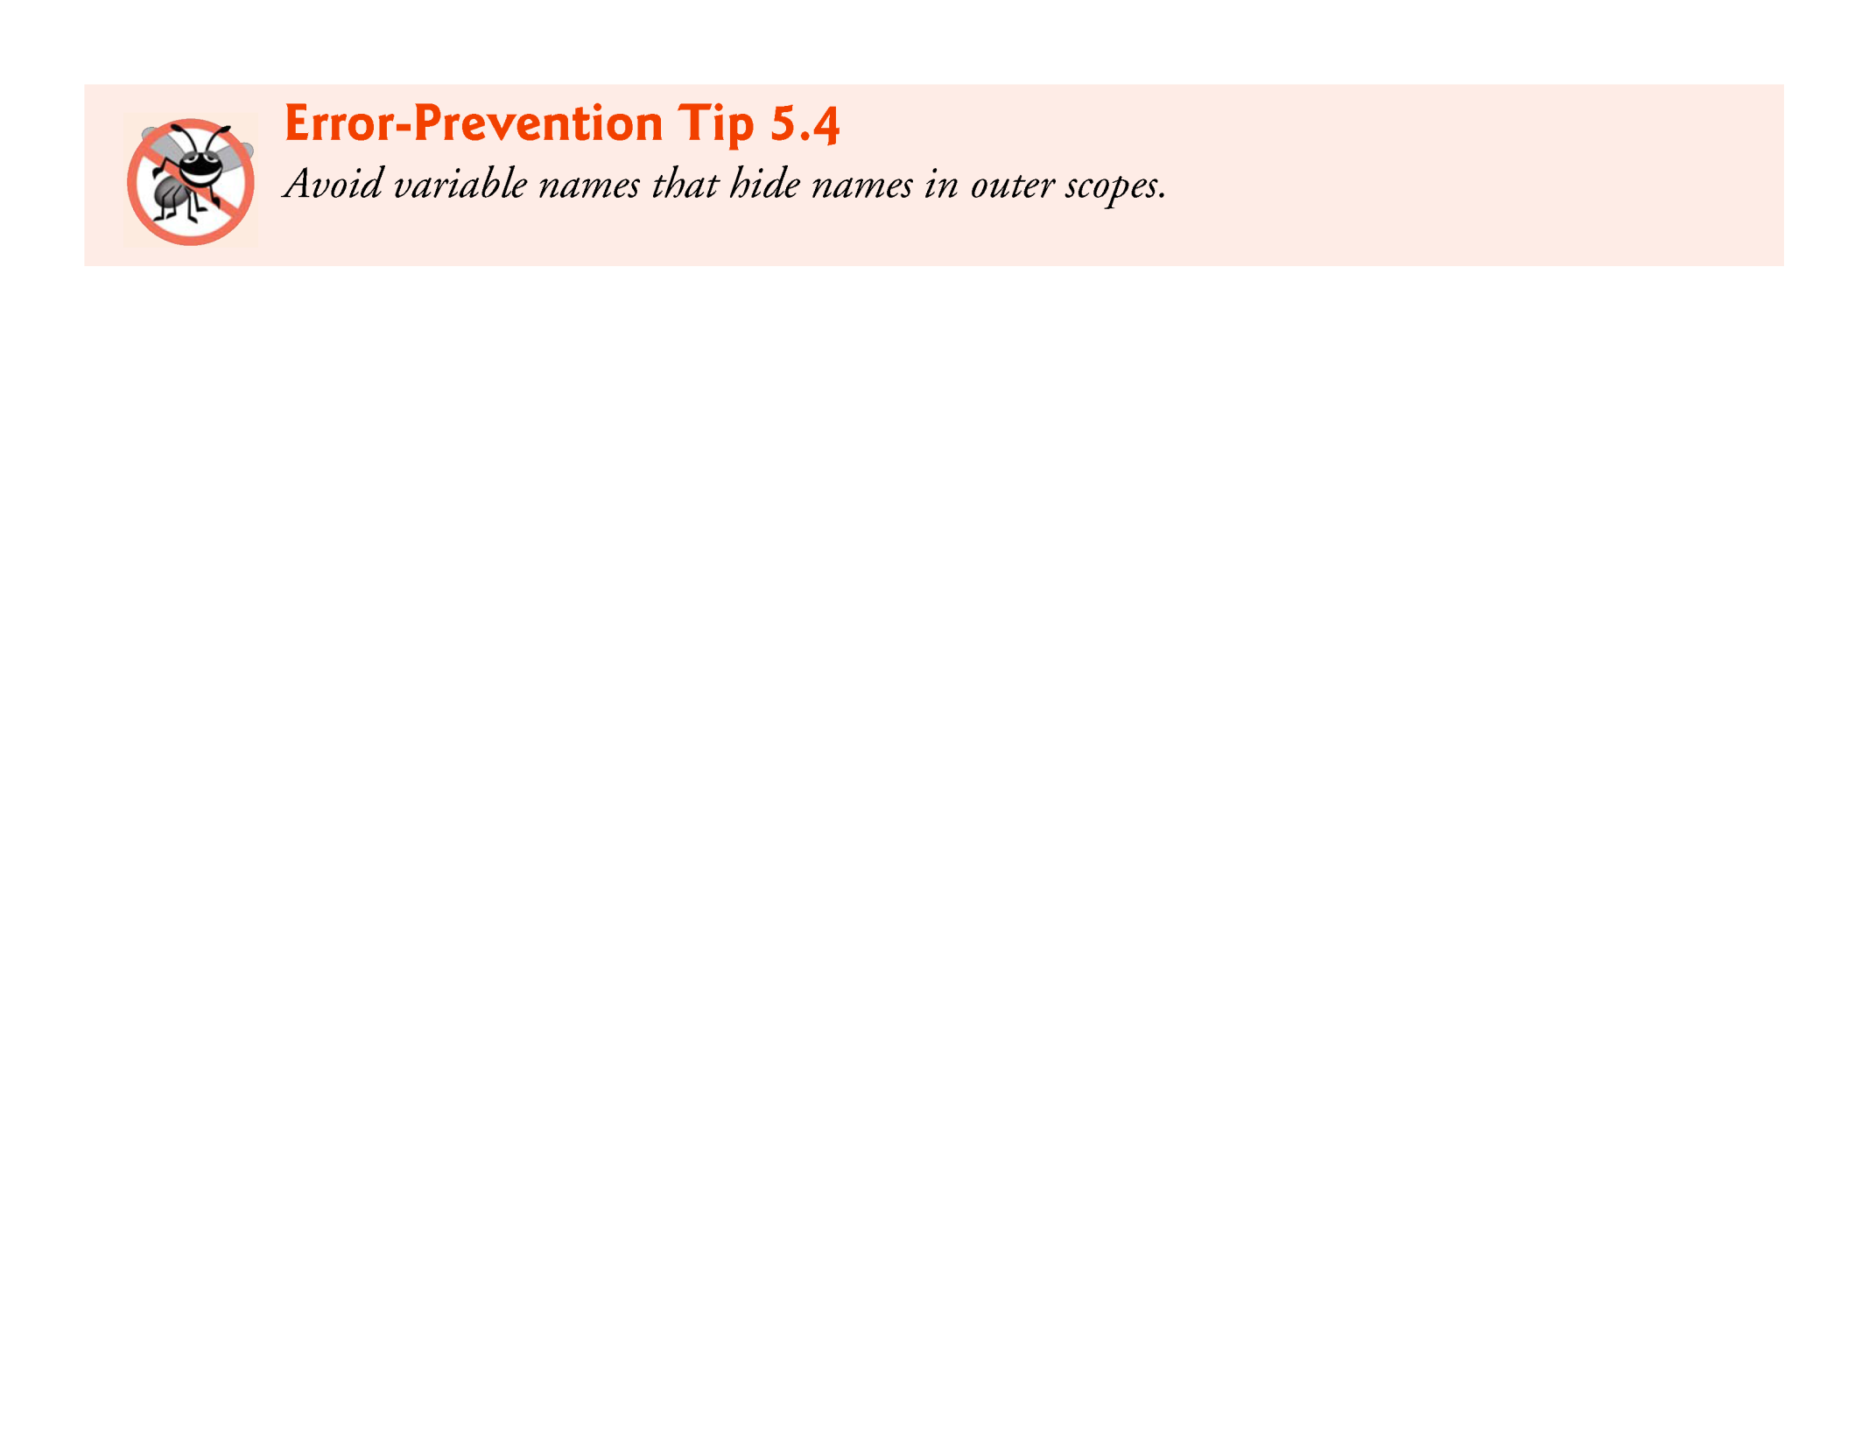

Slide 37
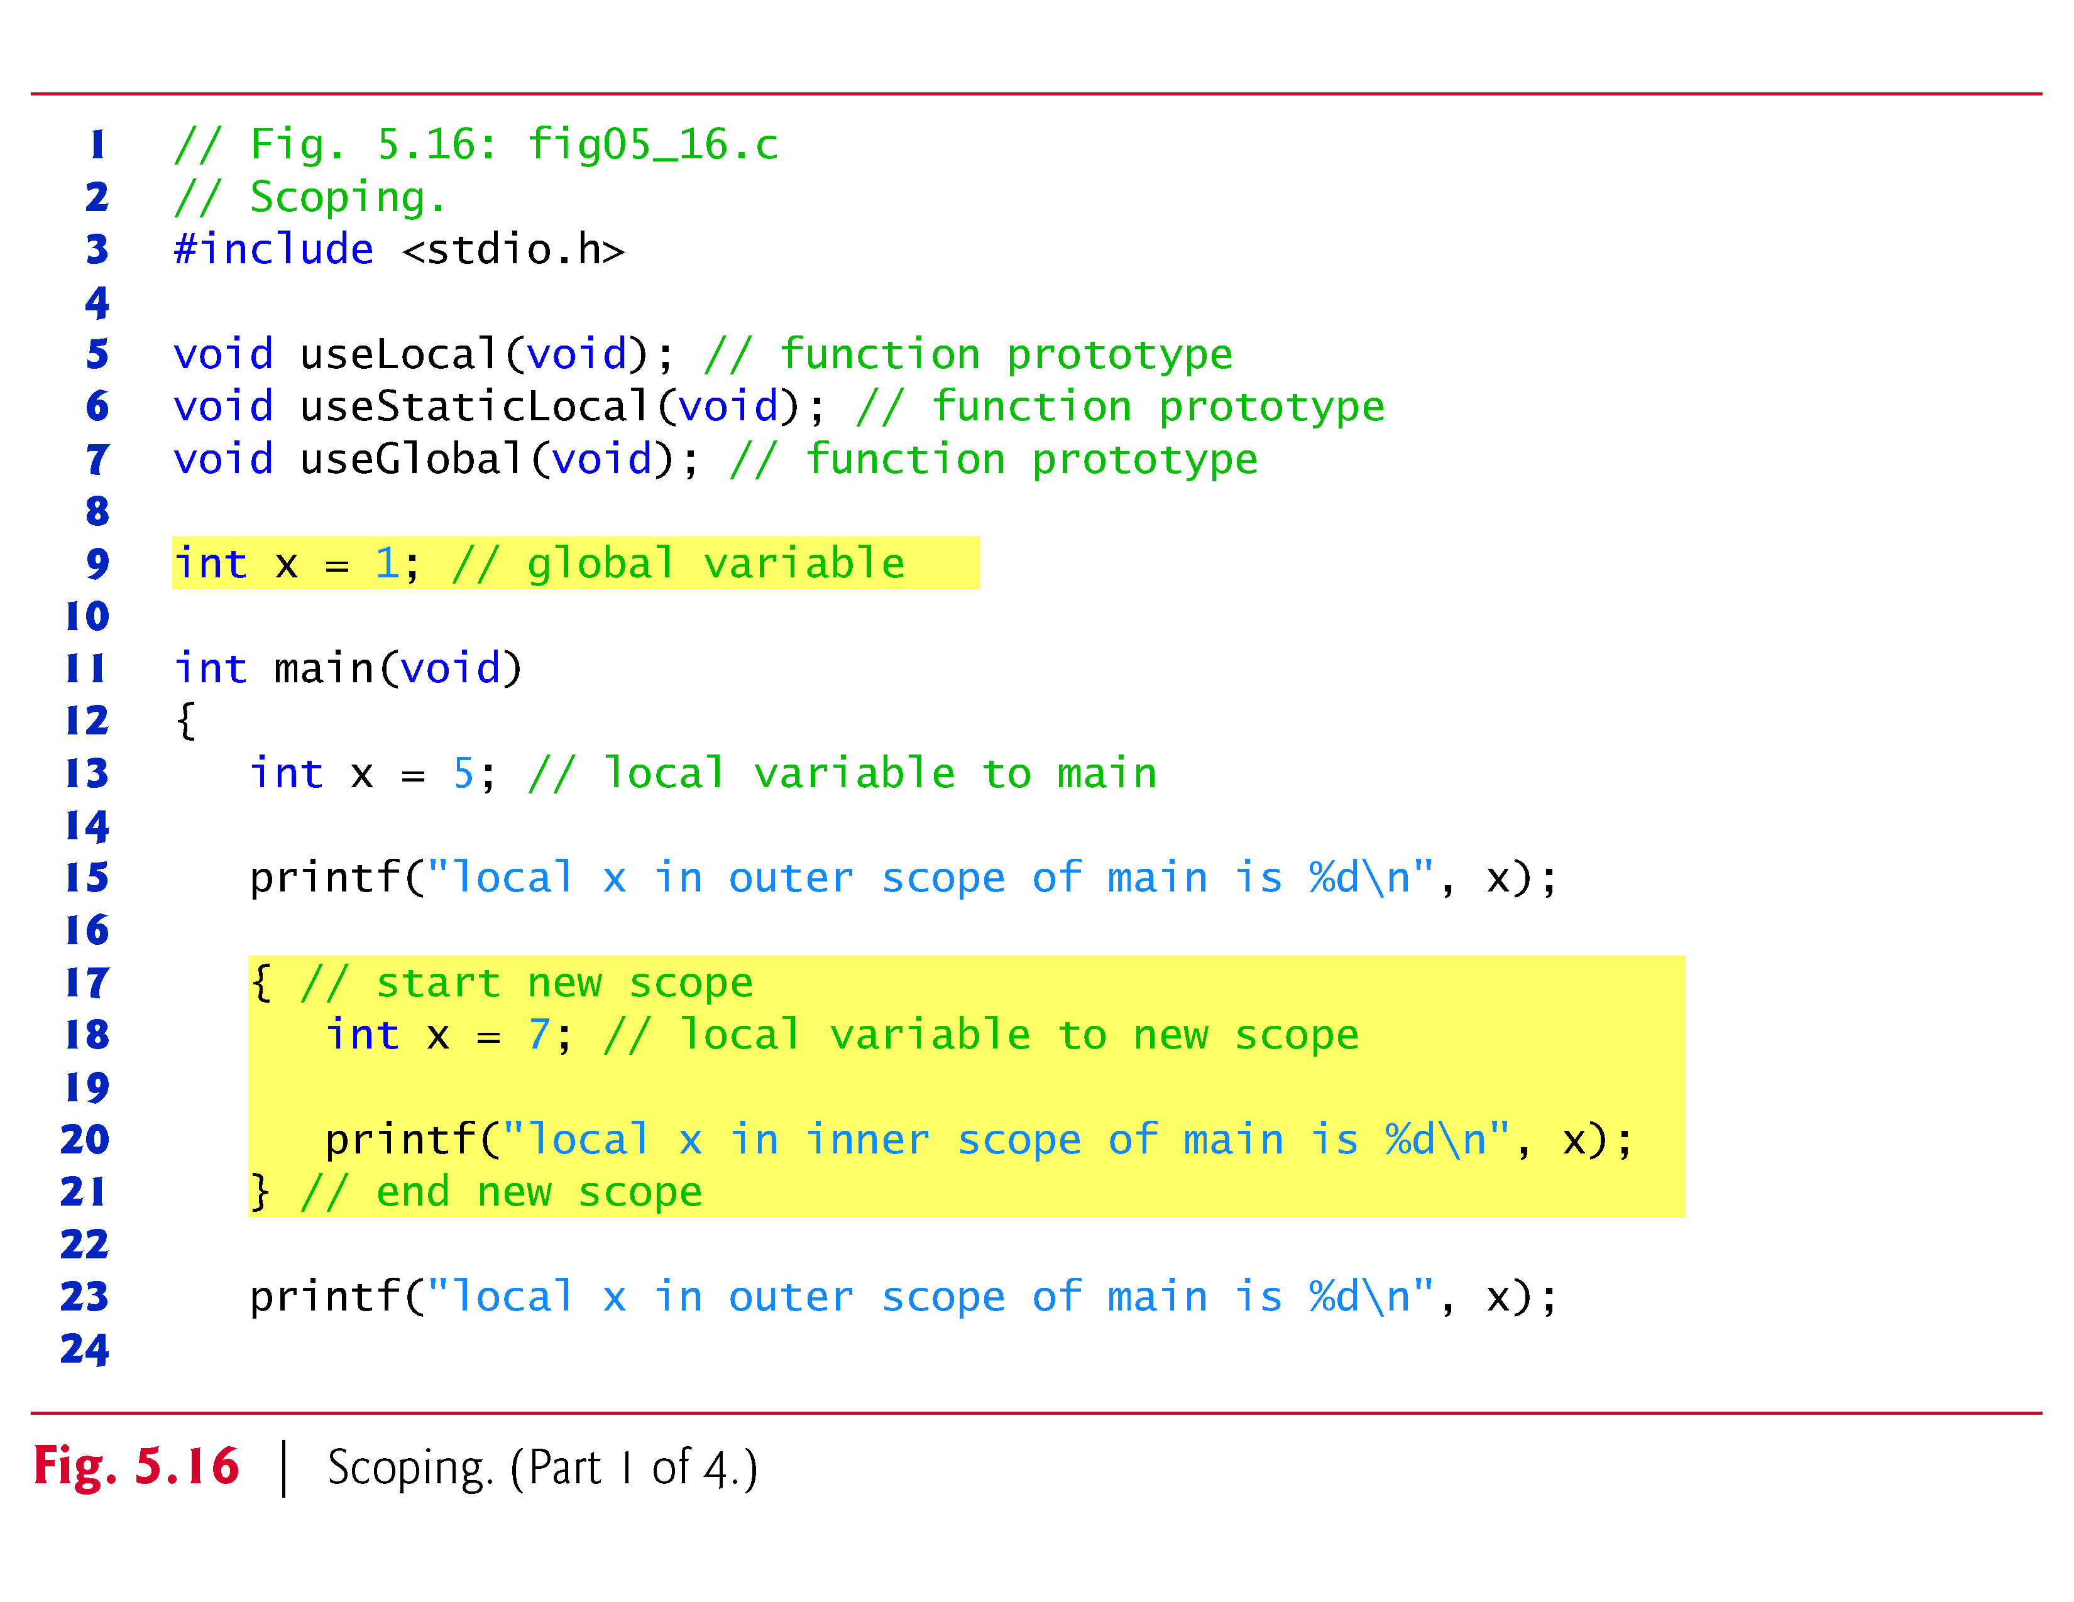

Slide 38
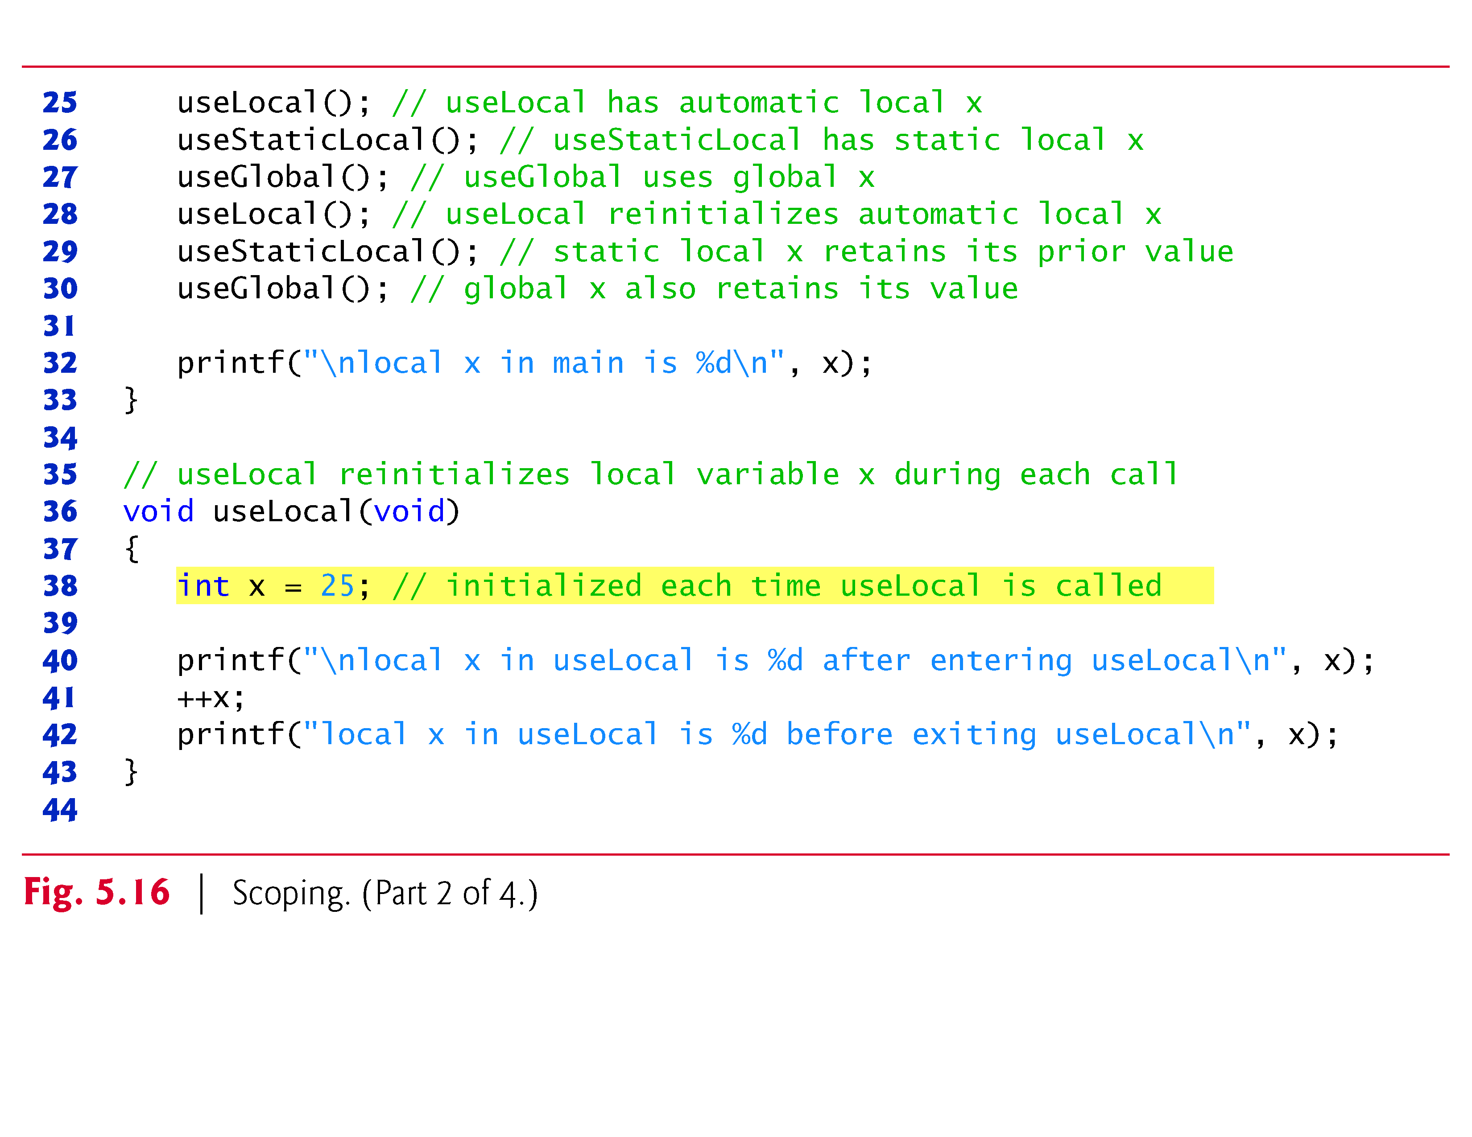

Slide 39
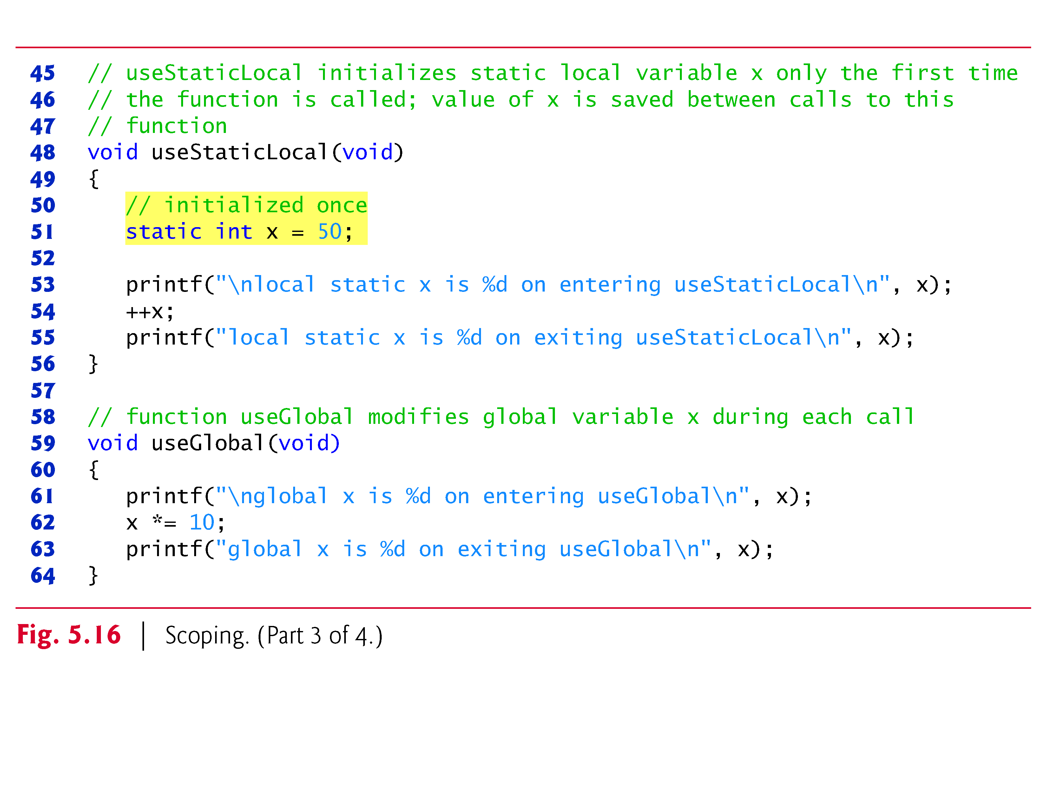

Slide 40
Scope Rules (Cont.)
Figure 5.16 demonstrates scoping issues with global variables, automatic local variables, and static local variables.
A global variable x is defined and initialized to 1.
This global variable is hidden in any block (or function) in which a variable named x is defined.
In main, a local variable x is defined and initialized to 5
This variable is then printed to show that the global x is hidden in main.
Next, a new block is defined in main with another local variable x initialized to 7

Slide 41
Scope Rules (Cont.)
This variable is printed to show that it hides x in the outer block of main.
The variable x with value 7 is automatically destroyed when the block is exited, and the local variable x in the outer block of main is printed again to show that it’s no longer hidden.
The program defines three functions that each take no arguments and return nothing.
Function useLocal defines an automatic variable x and initializes it to 25
When useLocal is called, the variable is printed, incremented, and printed again before exiting the function.

Slide 42
Scope Rules (Cont.)
Each time this function is called, automatic variable x is reinitialized to 25.
Function useStaticLocal defines a static variable x and initializes it to 50
Local variables declared as static retain their values even when they’re out of scope.
When useStaticLocal is called, x is printed, incremented, and printed again before exiting the function.
In the next call to this function, static local variable x will contain the value 51.
Function useGlobal does not define any variables.

Slide 43
Scope Rules (Cont.)
Therefore, when it refers to variable x, the global x is used.
When useGlobal is called, the global variable is printed, multiplied by 10, and printed again before exiting the function.
The next time function useGlobal is called, the global variable still has its modified value, 10.
Finally, the program prints the local variable x in main again to show that none of the function calls modified the value of x because the functions all referred to variables in other scopes.

Slide 44
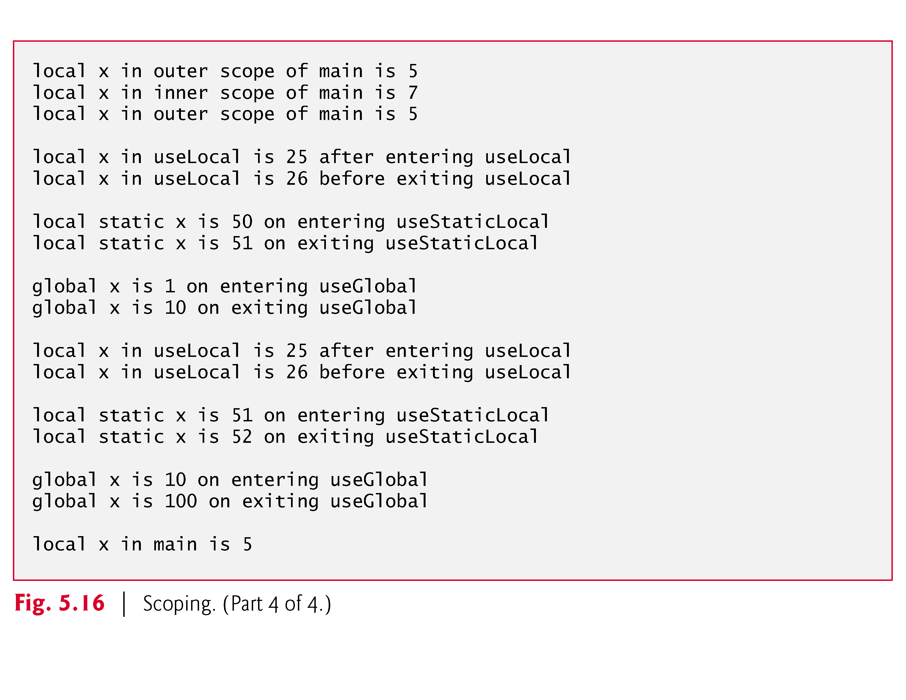

Slide 45
Self-Assessment Quiz
Which of the following is not true of static local variables?
static
a
They’re accessible outside of the function in which they are defined.
b
They retain their values when the function is exited.
local
global
c
They’re initialized to zero if not explicitly initialized by the programmer.
d
Their values can be changed.

Slide 46
Quiz Result
Sorry, your answer is wrong ☹
Try Again!
static
local
global

Slide 47
Quiz Result:
Excellent! ☺
Which of the following is not true of static local variables?
They’re accessible outside of the function in which they are defined.
static
Continue
local
global

Slide 48
Headers
Each standard library has a corresponding header containing the function prototypes for all the functions in that library and definitions of various data types and constants needed by those functions.
Figure 5.10 lists alphabetically some of the standard library headers that may be included in programs.
You can create custom headers.
Programmer-defined headers should also use the .h filename extension.

Slide 49
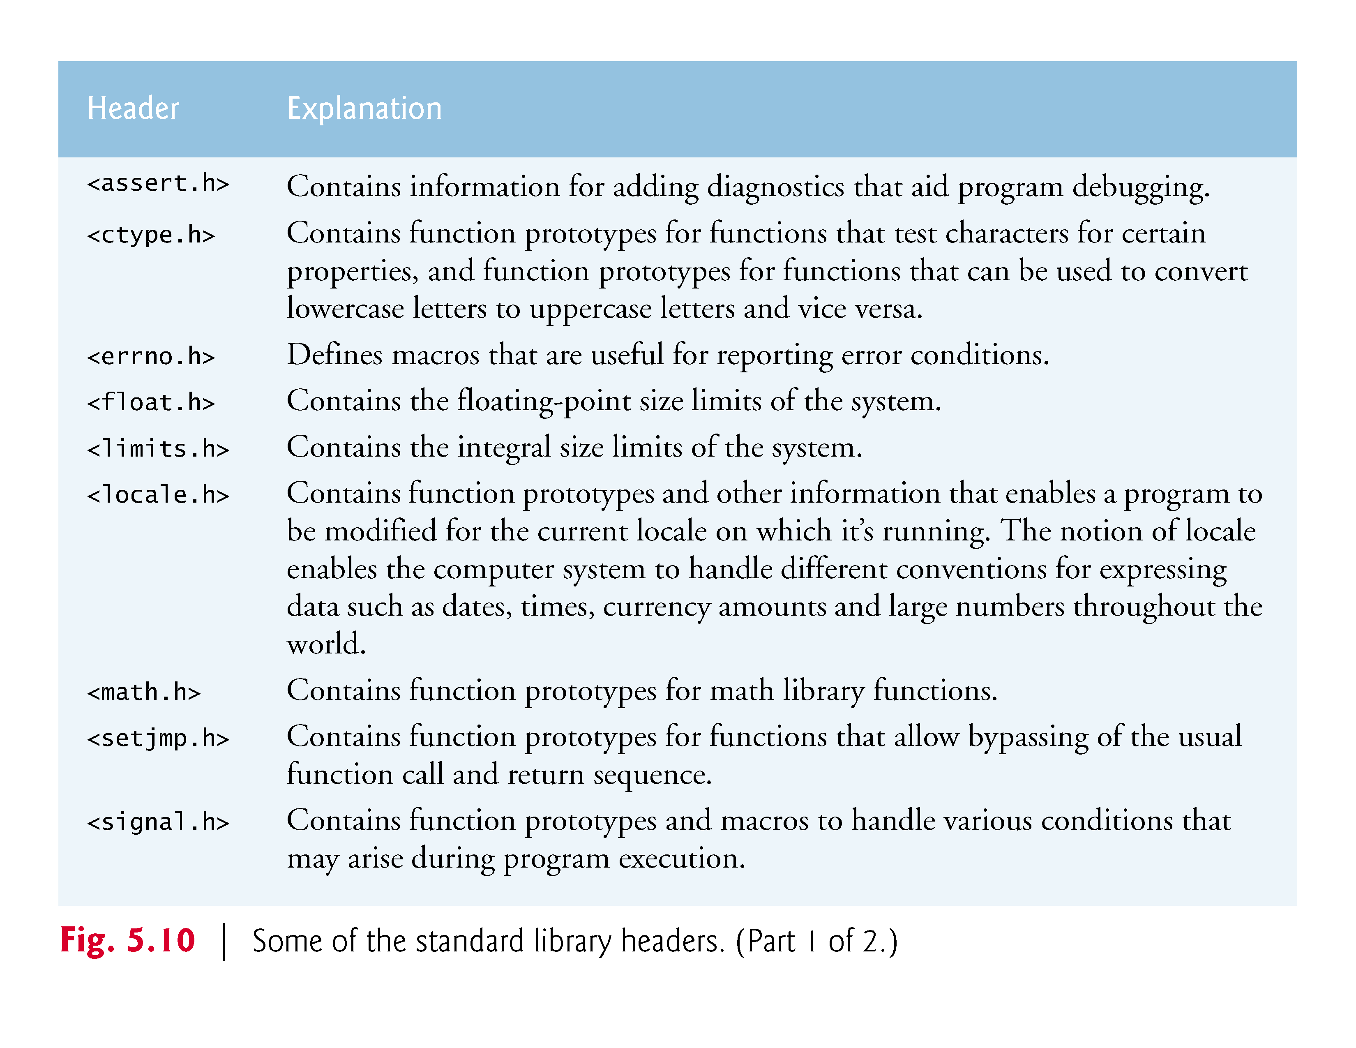

Slide 50
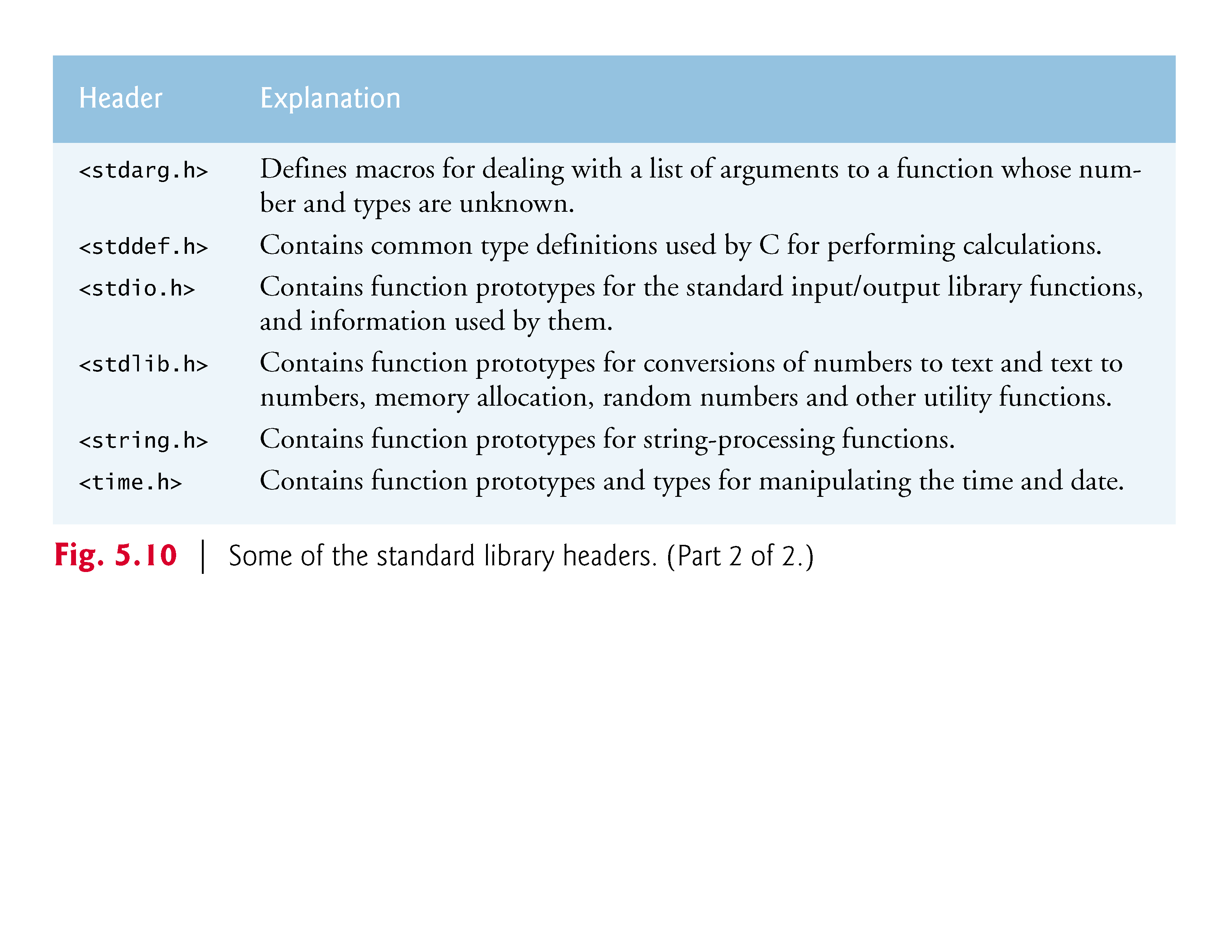

Slide 51
Headers (Cont.)
A programmer-defined header can be included by using the #include preprocessor directive.
For example, if the prototype for our square function was located in the header square.h, we’d include that header in our program by using the following directive at the top of the program:
    #include "square.h"

